Slide 1
SIMPOD GROUP
By: Claudia Johana Agudelo, Andrea Mendoza, Luis Fernando Muñoz, Juan David Marín

Slide 2


TEAM LEADER
TEAM MEMBERS
Claudia Johana Agudelo: Industrial Engineering student (5th semester)
Luis Fernando Muñoz: Systems Engineering student (5th semester)
Andrea Mendoza Cruz: Industrial Engineering student (5th semester)
Juan David Marín: Systems Engineering student (6th semester)
Claudia Johana Agudelo

Slide 3

SUMMARY
The purpose of this project is to create a module of a free, multiplatform, user friendly application that can be used for solving engineering problems by the SIMPLEX method, this is planned to be developed by a methodology based in prototypes using JAVA as the programming language.

Slide 4
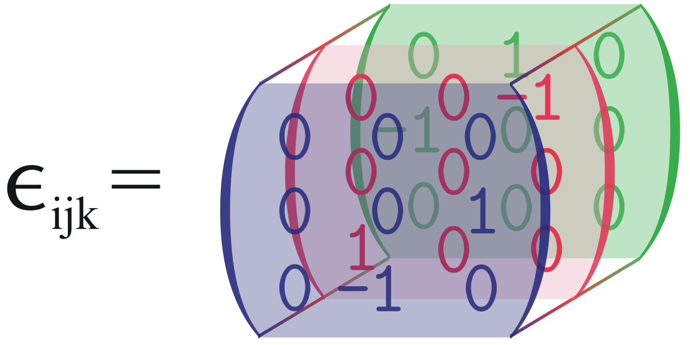

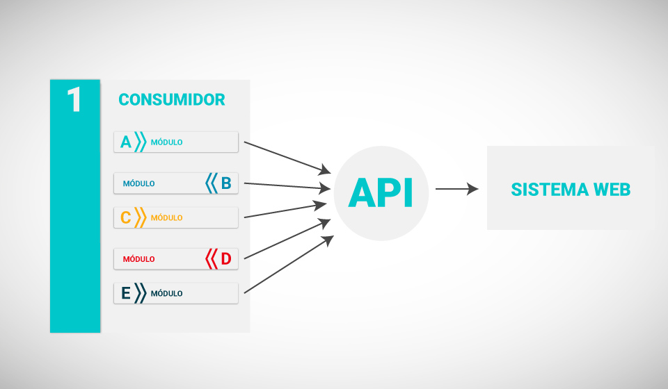
KEYWORDS
App module
SIMPLEX method
Matrix
Linear algebra
Constraints
Optimization
Java API
Prototype methodology

Slide 5

RESEARCH PROBLEM
Effectiveness of supporting, facilitating and complementing the process of industrial engineering education with a complete, interactive and user friendly tool that apply the Simplex method concepts.

Slide 6

Justifications
This Project starts as a necessity of supporting the operational research education by a free multi-platform tool.
There's no existing actualized tool designed for solving engineering problems that is free to any user for education.
Nowadays, technology has an important role in education. It’s essential for students and teachers to use tools that help to solve problems that simulate real life conditions.
For us, as students, a main reason for being part of this project is to apply and reinforce the knowledge acquired in classes. By the other hand, it’s a way of having the opportunity of working in a multidisciplinary team sharing our different abilities.

Slide 7

OBJECTIVES
SPECIFIC
Reinforce the knowledge about SIMPLEX method and Object Oriented Programming (Java).
Explore and apply complementary tools for matricial operations for developing the SIMPLEX method in Java.
Use WinQSB and other existing tools that use SIMPLEX method for analyzing them and find oportunities of improvement.
Acquire the skills for using GitHub as a collaborative development tool.
GENERAL
Develop a module of an educative tool that solve linear programming problems by using the SIMPLEX method.

Slide 8
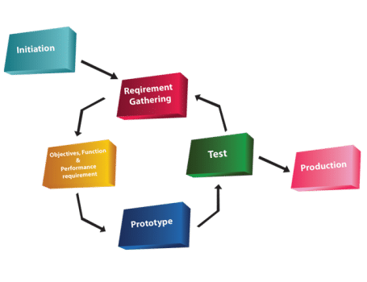
METHODOLOGY
The methodology that is going to be applied in this project is based in prototypes. The methodology is characterized by the following stages:
- Understand the context (Achieve the necessary understanding of the SIMPLEX method)
- Functional and non functional requirements due to the problematic - Design a model using UML (The model of the solution based in SIMPLEX method)
- Implement the model (using programming language-JAVA)
- Development a prototype evaluation (Minimum Viable Product that allows a feedback for future improvements of the module)
- Refinement of the prototype (Use the feedback for implement the oportunities of improvement found in the previous step)
- Final product obtained by iteration

Slide 9

EXPECTED RESULTS
Develop a module that solves optimization problems using the Simplex Method.
Create a source code on Java that performs the Simplex method.
Create a reusable program that can be scalable using decoupling techniques.
Show an Interface that promote the learning of the Simplex Method..

